Slide 1
User Interface II
Post-WIMP UI’s
Display and Interaction Devices
Andries van Dam

Slide 2
Post-WIMP UIs
Bill Buxton http://www.youtube.com/watch?v=jafms4w-Sso&feature=youtu.be
Gmail Motion http://www.youtube.com/watch?v=Bu927_ul_X0

Slide 3
Outline
WIMP vs. Post-WIMP
Natural User Interfaces (NUI’s) – e.g., pen and touch, speech
Distinguishing characteristics of devices
Input devices
standard
research
Output devices
display
other (haptic, sound)
Virtual devices
Immersive virtual reality and augmented reality

Slide 4

WIMP Pros
WIMP encourages ease of x: learning, remembering, transferring…
WIMP has become a “standard” GUI
But not everyone can or wants to use a mouse…and swipe/pinch-zoom are starting to dominate
Layers of support software => ease of implementation, maintainability
Toolkits (Swing, Qt, etc.)
Drag-and-drop interface builders (Xcode’s and Netbeans’ interface builders)
Lots of documentation about “how to come up with a good GUI”
“GUI Design for Dummies” by Laura Arlov (’97)

Slide 5

Impedance-matching Limitations of WIMP GUI
Limited Vision (Flat, 2D)
No Speech No Gestures
Limited Audio Limited Tactile
One Hand Tied Behind Back

Slide 6
WIMP Cons
Imposes ping-pong dialog model based on mouse and keyboard input, 2D graphics output
Deterministic and discrete (no gestures)
Hard to handle simultaneous input
Pure WIMP doesn’t use other senses: hearing, touch…
70% of our neurons in visual cortex, but try to communicate without speech, sound…
Does not support multiple, simultaneous users
Not usable in immersive VR

Slide 7
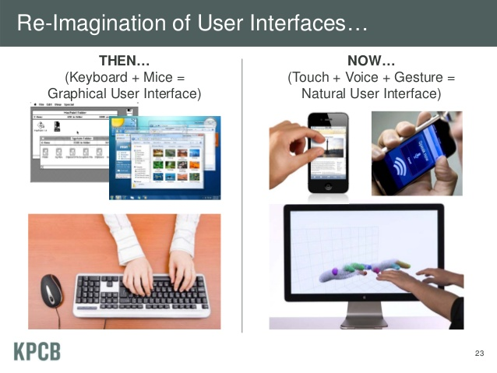
Post WIMP
http://venturebeat.com/2012/12/03/mary-meeker-releases-stunning-data-on-the-state-of-the-internet/

Slide 8
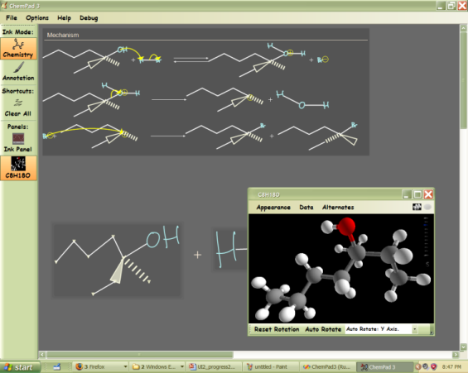
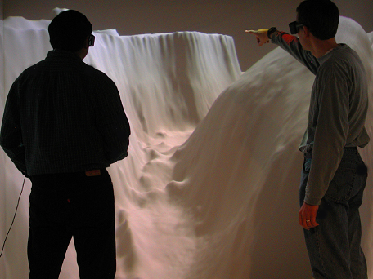
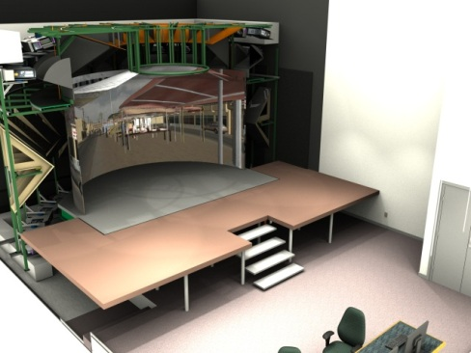
Post-WIMP interfaces (1/2)
Gestural interfaces
Our Pen and Touch Computing center
Music Notepad
MathPad
ChemPad
Lineogrammer
TAG (Touch Art Gallery)
WorkTop
IVR (Immersive Virtual Reality) interfaces: headtracked stereo
VENLab (see slide 49)
The Cave (see slide 50)
An emulation of the Martian surface on old Cave
New Cave

Slide 9
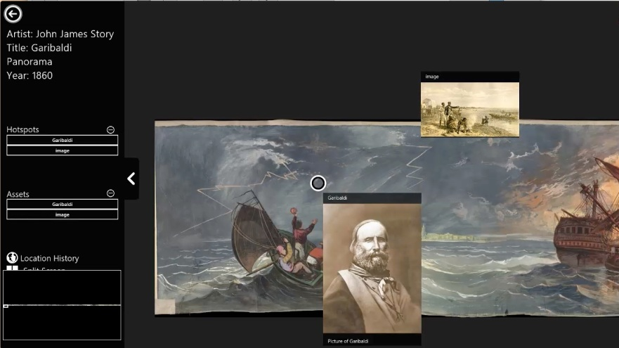
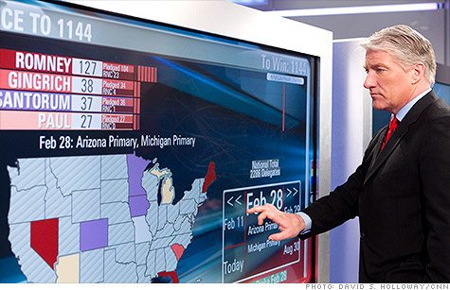
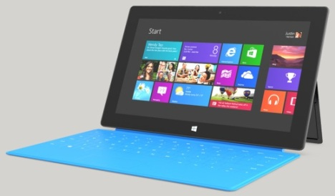
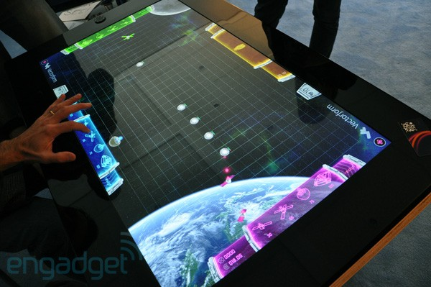
Post-WIMP interfaces (2/2)
Multitouch
Jeff Han’s Perceptive Pixel, Inc (see slide 33)
Microsoft Surfaces
The little one - Windows 8 tablet
The big one - Samsung SUR40
Touch Art Gallery (TAG)
Windows 8 app for viewing artwork
TAG
PPI
Surface
Samsung SUR40

Slide 10
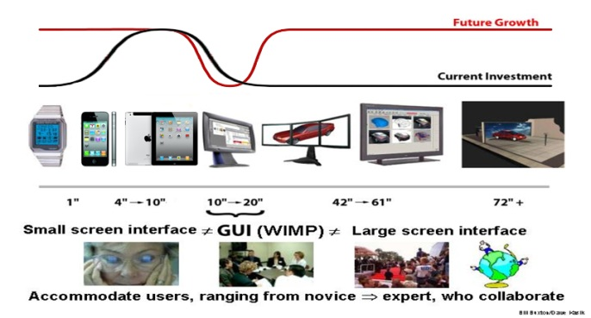
Post-WIMP World: Push and Pull
Push from new technology, from form factors
Smart phones, tablets, Interactive whiteboards, wearables
Embedded computing, smart x
Pull from new applications that both leverage and drive technology trends
These interact to raise expectations continuously
Investment picture is still inverted!
But “minimalist GUI” Windows 8 RT is touch-centric
overly focused on slates – bezel gestures inappropriate for large interactive whiteboards

Slide 11
WIMP GUI’s Will Be Augmented, Not Replaced
UI spectrum
Direct control (direct manipulation, drag-and-drop, 2D and 3D widgets)
Indirect control (agents, social interfaces)
WIMP enhanced by
Speech and gesture recognition, passive sensing (video based)
Agents
From Human Computer Interaction (HCI) to Human Human Interaction (HHI), from Personal Computing to Collaborative Computing
Each human typically controls many devices and user interfaces (society of appliances, federation/eco-system of devices, ubiquitous computing (ubicomp)…)
But most should be part of peripheral (“situational”) awareness, NOT part of our focus
Support team work (e.g., MMRPG’s): synchronous and asynchronous, co-located and distributed, designed and spontaneously formed (crowd sourcing, Mechanical Turk)

Slide 12
Post-WIMP Characteristics
Multiple channels; possibly multiple participants
High bandwidth, continuous input
Body part tracking (head, hand…)
Gesture and speech recognition=>probabilistic disambiguation (e.g., handwriting recognition for pens and fingers, computer-vision based body tracking w/ Kinect and in IVR)
Multimodal interfaces: mutually reinforcing parallel channels (e.g., pen/touch + speech)
The latest buzzword: natural user interfaces (NUI), including agents
Autonomous objects in active world
MIT Media Lab’s “Put that there” from the 80’s
First multi-modal UI (gesture + speech)
http://www.youtube.com/watch?v=MDOQkGn9mic

Slide 13
Display and Interaction Devices
Roadmap
Distinguishing characteristics of devices
Input devices
standard
research
Output devices
video
other
Virtual devices

Slide 14
Input Device Hardware (1/3)
Hardware characteristics
Absolute vs. relative
Polled vs. interrupt-driven
Discrete vs. continuous input
Degrees of freedom (DOF)
number of simultaneous, independent data values that arrive in one record
normally 1, 2, 3, or 6
Potential problem areas
Spatial resolution
Registration and calibration
Accuracy and repeatability
Sample frequency (temporal resolution)
Lag
Data synchronization
Abstractions
Hardware level
Logical level

Slide 15
Input Device Hardware (2/3)
Device interface level
Wired vs. wireless
Connection
Universal Serial Bus (USB; now v3.0)
External SATA
Bluetooth
WiFi (IEEE 802.11)
Power source
AC power supply
batteries
mechanical motion, solar
connection to computer
Type of data transferred
binary or text
floating point, integers, text, etc.

Slide 16
Input Device Hardware (3/3)
Logical level
Divides devices into task-oriented categories
navigation in a scene
object selection
positioning of an object or camera in 1, 2, 3 or more dimensions
orientation of an object or camera in 1, 2, 3 or more dimensions
text input
scalar value input
ink, i.e. draw a line, paint a path
indication of complex shape contours
Hides hardware issues such as absolute vs. relative values
Can be remapped in software
Logical abstractions easy for WIMP, more difficult for non-WIMP and Immersive VR applications
non-deterministic, noisy input means difficult probabilistic disambiguation, backtracking
mapping from n DoF devices to 2D or 3D
especially non-trivial for gesture recognition

Slide 17
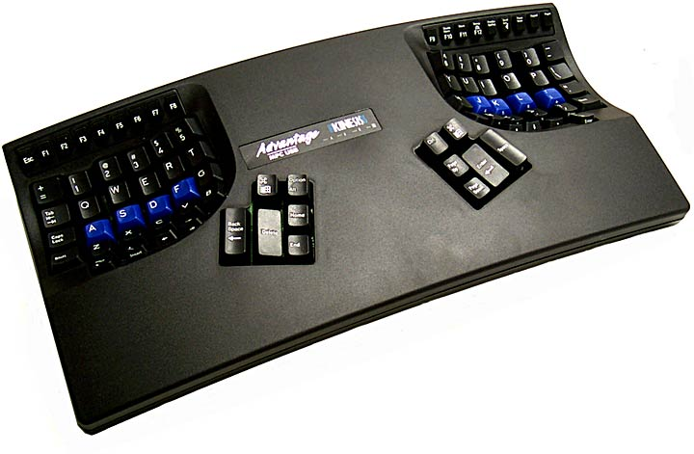
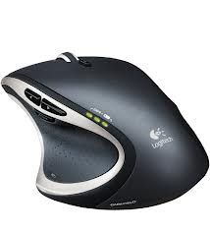
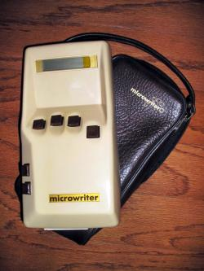
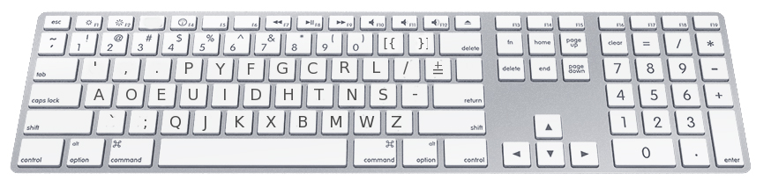
Traditional Input Devices (1/4)
Commonly used today
Mouse-like devices
mouse
wheel mouse (up to 2 wheels offer extra DOF)
trackball
trackpad
switch between them to avoid RSI!
Keyboards
QWERTY, Dvorak, Kinesis
one handed vs. two handed
standard vs. ergonomic
chording keyboards
Kinesis keyboard
Logitech mouse
Dvorak layout keyboard
Microwriter Mw4 with chording keyboard
For some historic keyboards see: http://www.slate.com/articles/arts/design/2012/12/crazy_looking_keyboards_that_never_caught_on.html

Slide 18
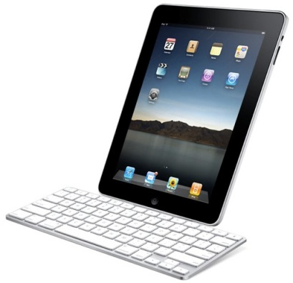
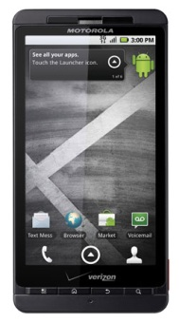
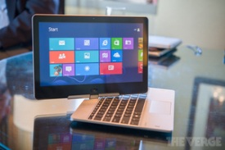
Traditional Input Devices (2/4)
Pen/Stylus
Data provided by “digitizer” integrated with screen
Position
Some give pressure, distance from surface (“hover state”)
Big two vendors today: N-Trig and Wacom
Digitizer tablets for desktop computers
Alternative to mouse, used by “creatives” (e.g., animators)
Tablet PCs (some can be used as laptops or slates)
iPad
HP EliteBook Revolve
Microsoft Surface (uses Wacom)
Hand-held devices
Smartphones/slates/pads/e-books
Apple: iPhone 5
Amazon: Kindle Fire
Barnes and Nobles: Nook
Android: Nexus 4 Droid X, etc..
iPad with keyboard dock
Droid X
HP Revolve
(can be detached and used as a tablet)

Slide 19
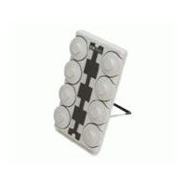
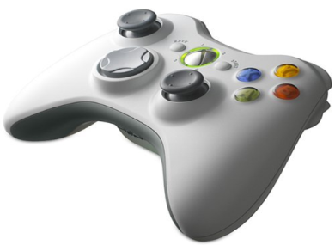
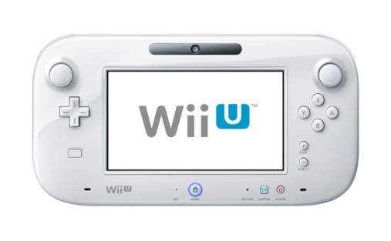
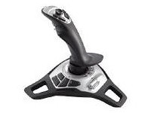
Traditional Input Devices (3/4)
Dial boxes
Number of dials (1 DOF per dial)
Joysticks
Game pads (Xbox and Nintendo Wii U controllers)
Flightsticks (2 or 3 DOF plus a myriad of buttons and sliders)

Slide 20
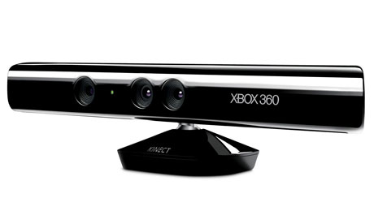

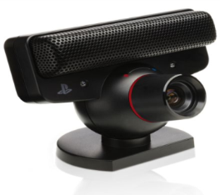
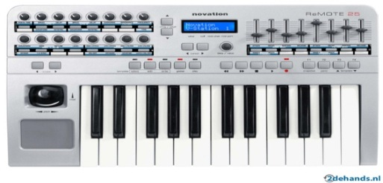
Traditional Input Devices (4/4)
Microphones
Wireless vs. wired
Headset, unencumbering
Digital still and video cameras, scanners
PS3 Move: Motion/controller input hybrid
PS3 Eye, Microsoft Kinect
uses basic image recognition to track body movements as an input to console games
Kinect more advanced, depth sensor helps build actual 3D skeleton of users
MIDI devices
Input from electronic musical instruments
More convenient than entering scores using just keyboard/mouse
Kinect
Eye
Move

Slide 21
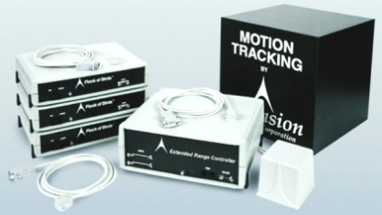
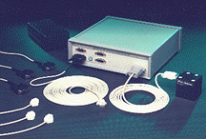
3D Input Devices (1/2)
Electromagnetic trackers
3 or 6 DOF (position and orientation in space)
can be attached to any head, hands, joints, objects
must deal with noise, calibration
Polhemus FASTRAK™(used in Brown’s old Cave)
provides X,Y,Z position and Euler angle orientation at 120 Hz, and 0.03” accuracy
receivers attached to user detect a field generated by a mounted transmitter
no interference from metal objects
wider range, higher accuracy
Ultrasonic trackers
Intersense IS-900
receivers attached to user detect ultrasound from many inexpensive and small emitters to determine position
also uses inertial measurement unit to determine angular acceleration, integrate for orientation

Slide 22
3D Input Devices (2/2)
Active vs. Passive input devices
Active tracking – input device generates a signal which is interpreted by CPU
examples: Original Wii controller, Wanda
these devices have limitations
resolution, restricted sweet spot/region, linearity within that region, noise, latency
intrusiveness through wires and tethers (not so much anymore with Bluetooth and other tech)
Passive tracking – input device doesn’t produce a signal. It’s characteristics are interpreted by some external device
examples: Hollywood motion capture, PS3 Move, Microsoft Kinect; newest: Leap Motion
video of Leap Motion: https://www.youtube.com/watch?v=_d6KuiuteIA
typically based on video cameras and markers (no markers for Kinect, as it also has help of depth sensors)
can compute 6 DoF for head gaze or hand position/orientation
new problem of view occlusion (user puts his/her hand with a marker in pocket)
still susceptible to latency issues of active tracking

Slide 23
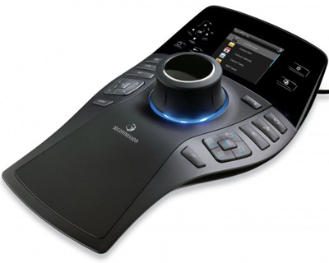
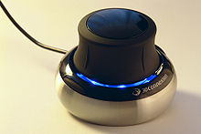
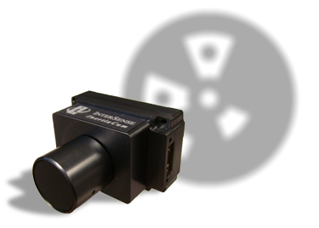
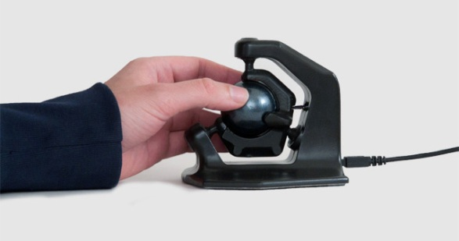
Less Popular 3D Input Devices
Mouselike
relative 6 DOF, with multiple buttons
6 DOF trackers are easier to control and versatile
3Dconnexion SpacePilot and SpaceNavigator
compatible with 3D applications such as Maya, Blender, Google Earth, etc.
Hybrid
InterSense IS-1200 Optical tracker
Axsotic 3D-Mouse
provides “true” 6 degrees of freedom
SpacePilot Pro
SpaceNavigator
InterSense IS-1200
Axcotic 3D-Mouse

Slide 24
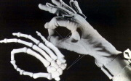
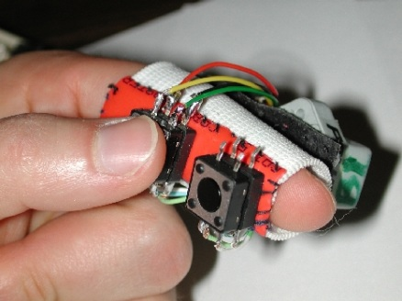
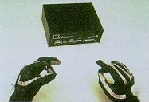
Old 3D Input Devices
Gloves
Attach electromagnetic tracker to the hand
Pinch Gloves
Contact between digits is a “pinch” gesture
In Cave, extended Fakespace PINCH ™ gloves with extra contacts
Brown’s FingerSleeve – a single finger device combines tracker and pop-through buttons

Slide 25
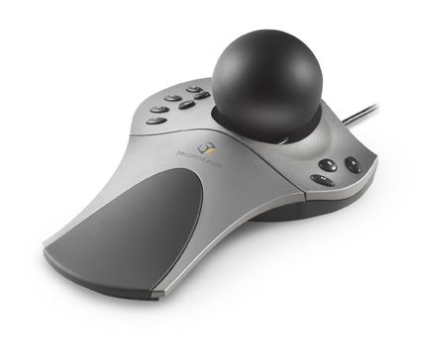
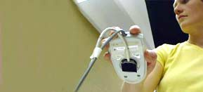
Unsuccessful Old 3D Input Devices
Commercial failures
Spaceball
broke ground for the Magellan puck
6 DOF designed for easy navigation
mostly used for 3D modeling
Flymouse
tracks motion of mouse held in mid-air
limited range of motion

Slide 26
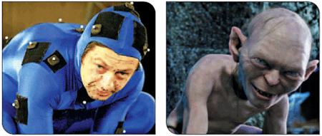
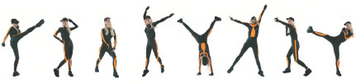
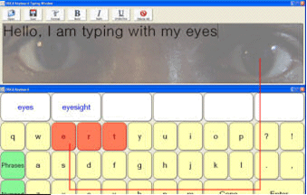
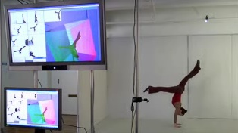
Products for specialized markets
Animation/keyframing
Full body and facial motion capture
Eye tracking
Typing using only motion from eyes
assistive technology
Andy Serkis doing motion capture for Gollum
www.moven.com
http://www.specialneedscomputers.ca/c-erica.htm
www.organicmotion.com

Slide 27
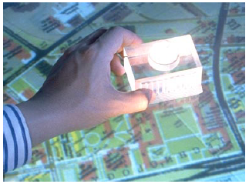
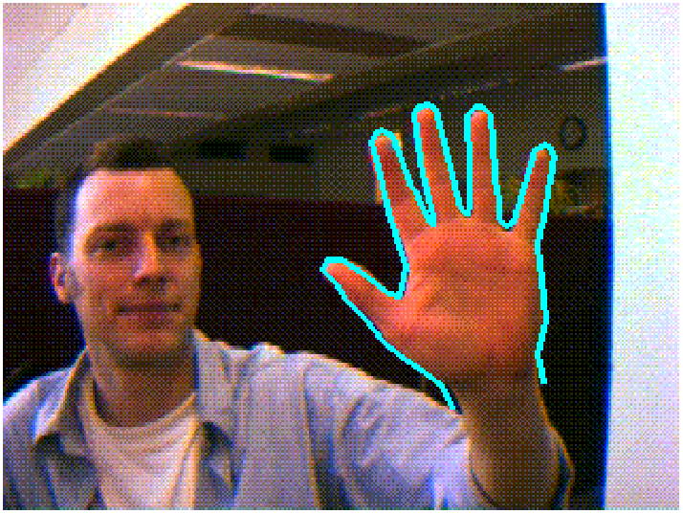
Some Current Input Device Research
Non-standard Input Devices
Reconfigurable devices
Brown’s Lego toolkit
Tool handles/props, with attached sensors
Phicons (physical icons, Hiroshi Ishii, MIT Media Lab)
Passive input devices
Premise: all devices are encumbering
repetitive stress
limited range of expression
unsanitary
Would like to separate users from devices
Voice recognition without a headset
Image-based analysis
video camera trained on user
gaze tracking
gesture tracking
expression tracking
see multitouch (next slide)

Slide 28
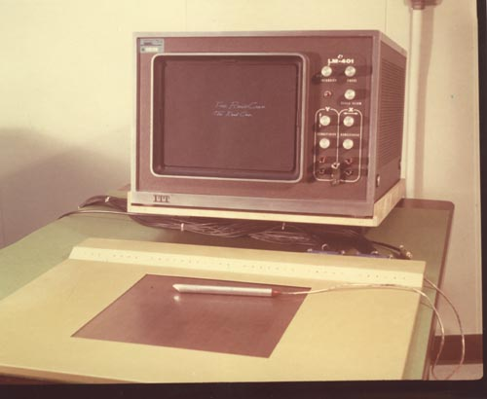
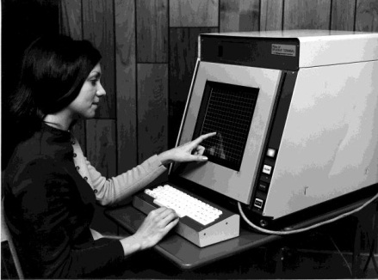
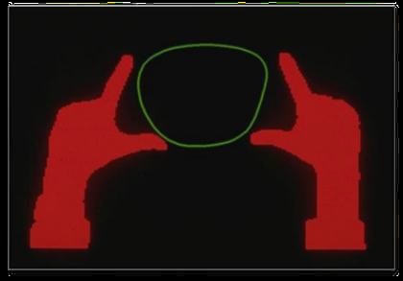
Touch Research History (Buxton http://billbuxton.com/SID10%2031-1.pdf)
Digitizer tablet (touch pad + pen) for displays in early 60s, e.g., Rand Tablet
Grid of wires under surface encoded horizontal and vertical coordinates in a small magnetic signal. Stylus receives magnetic signal, decoded as coordinate information
Ditto touch on display screens using light interruption of infrared beams, etc. (touch screen vs. touch pad)
1972 PLATO IV Terminal with touch screen and plasma panel display
Optical: video camera captures shadows from underside of a translucent surface
Image processing/computer vision algorithms for gesture recognition (selection, pinch-zoom,…)
University of Toronto 1982
Myron Krueger in early 80s (Artificial Reality, Addison-Wesley, 1983)
MSFT Surface I in 2009 (camera for hands, infrared for pen)
Jeff Han’s Ph.D. work on FTIR (Frustrated Total Internal Reflection) , his TED talk
“Surface computing” on tabletops, smartphones, pads, slates, etc.

Slide 29
Major Touch Technologies Today: finger(s) change state of digitizer
Optical: finger blocks light/casts shadow
Capacitive (see next slide): touching the screen changes the amount of electrical charge in the capacitors at the points of contact
Resistive: pressure of finger causes conductive and resistive layers to touch, altering resistance
Pen/marker can have separate sensor (e.g., infrared or electro-magnetic) or treated as finger (less useful); some have tip switch on marker/stylus

Slide 30
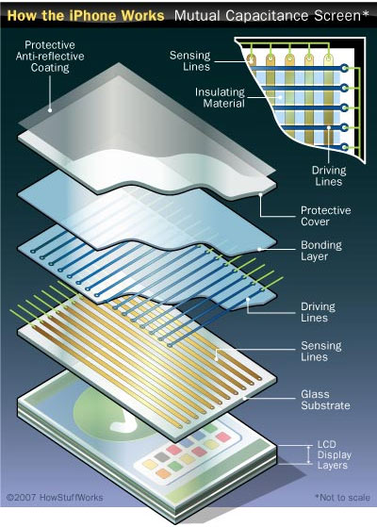
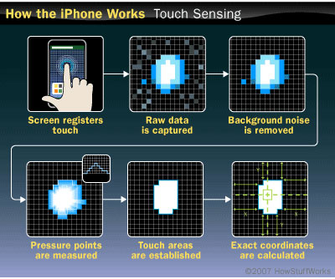
Multitouch Example – iPhone
Touch-sensitive screen includes a layer of capacitive material
iPhone’s capacitors are arranged in a coordinate grid
Every point on grid generates it’s own signal when touched
Allows iPhone to determine location and movement of simultaneous touches
Images: electronics.howstuffworks.com/iphone.htm

Slide 31
Multipoint and Multitouch
Multipoint
Can use multiple fingers at once, but only approximate “centers” of contact ellipses are taken into account
No need for buttons!
UI elements, including keyboard, can be displayed on screen
iPhone, iPad, Macbook Pro trackpad
Multitouch
Take into account complete contact ellipse
Can be used to differentiate angle of touch, to provide different commands, to simulate pressure, etc.
For digital ink, size of ellipse can be used to modulate thickness of stroke (calligraphy, painting…)

Slide 32
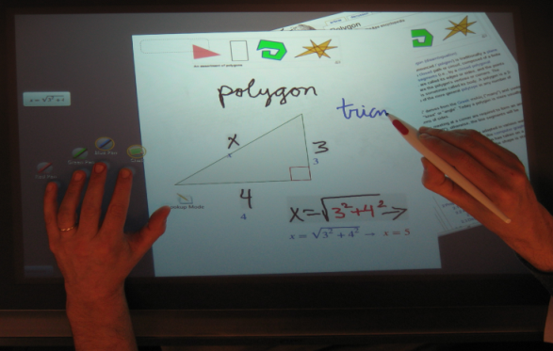
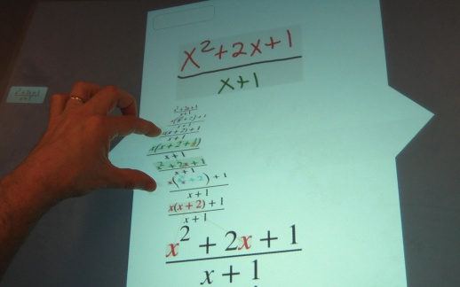
Bi-manual Operation
Palm Rejection:
When using a pen/stylus, how to deal with palm resting on area of input?
software has to be able to differentiate pen input from palm input (ignore everything but small diameter contact ellipse from pen)
Most software doesn’t allow simultaneous pen and touch - palm rejection s/w favors pen over touch
Prevents bi-manual operation, using both hands simultaneously
e.g., use dominant hand for fine motor control (text and shapes) and non-dominant hand for coarse motor control (moving the virtual paper, menus, moding pen)
Need to distinguish pen and touch as different inputs and to allow the two to coexist/collaborate
Examples
our Hands-on Math UI
See “In-Place commands” https://skydrive.live.com/redir?resid=C44277986A2873F1!4692&authkey=!AFXNJ6tuQtT2U3Q
Perceptive Pixel (see next slide)

Slide 33
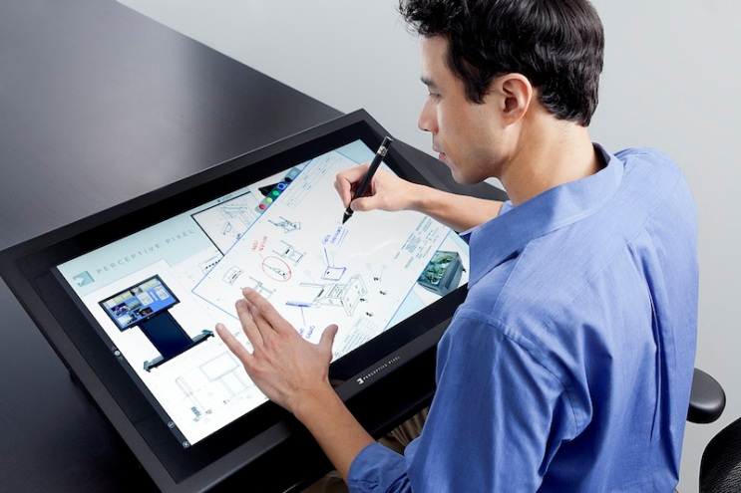
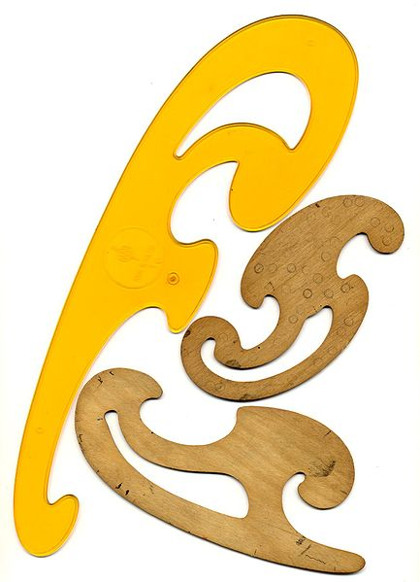
Perceptive Pixel
Perceptive Pixel (now part of Microsoft)
Line of multitouch displays capable of bi-manual operation (up to 82 inch)
differentiates simultaneous stylus and finger input, e.g., simulating manipulating a “french curve” or drawing with any kind of template
also capable of differentiating the input of four simultaneous users!
can register hover state of “active” stylus - capable of reporting information before pen actually touches screen
French curves

Slide 34
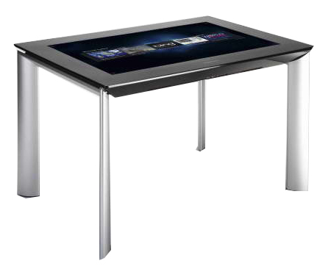

Surface and Tangible Computing
Buxton: Acoustic transducers are bidirectional, e.g., microphone/speaker; why not displays?!?
display pixel can be (R,G, B, I) where I puns eye and is basically a photo-sensor – example: Samsung’s SUR40: LCD for RGB, CCD for IR (infrared) for pen/touch
http://www.youtube.com/watch?v=kmOku92MlQc
Size matters (large screen displays, the Cave)
individual slates vs. classroom blackboards in “ed tech”!
multiple technologies will make it possible to replace whiteboards cheaply with 100-200 DPI color screens (e.g., Organic LEDs); can be put on thin, flexible substrates, cover your office, den or other rooms with dynamically updated interactive displays
“phicons”/tangible objects become interesting when they have built-in intelligence
surface becomes connecting "ground" on which these "figures“ interact and amplify their ability, e.g., interoperate smart phone, digital camera and table display
Most important capability is seamless interconnection and transparent movement of context (“working set”) between devices

Slide 35

Virtual Input Devices (1/8)
a.k.a. gestures and 3D widgets
Part of a windowing system, UI toolkit, or 3D environment
Widgets – a combination of behavior and geometry
Motivation
Advanced hardware devices are expensive, and not always available for all platforms
Most users already know how to use traditional input devices (mouse & keyboard)
It is inefficient and difficult to have to continuously switch devices
try to keep hands on the mouse or the keyboard
Would like to perform complicated inputs with simple gestures
You implemented a virtual trackball and other virtual input devices in the Modeler Lab!

Slide 36

Virtual Input Devices (2/8)
2D widgets
Windowing systems (e.g. X, Mac, Windows)
window
scrollbar
UI toolkits (e.g. Java Swing/AWT, Cocoa, Qt, WPF)
button
dialog box
drawing area
object handles
Simulating hardware devices
sliders as virtual dials
windows as virtual tablet
Swing widgets

Slide 37
Virtual Input Devices (3/8)
3D widgets
Ambiguity of gestures
2D mouse gesture → 3D movement
interface must make decisions
complex geometry involved to make these decisions
Fundamental differences between 2D and 3D graphics
multiple coordinate systems
hidden surfaces
more complicated primitives (3D objects, not 2D windows)
Combine geometry & behavior
make sure that target users can infer the widget’s functionality based on its geometry
reduce the cognitive distance between the function you are actually performing and the interaction you are doing
virtual devices should show the “affordances” of the actions they are designed to do

Slide 38




Virtual Input Devices (4/8)
Axis-aligned
Disambiguating 2D gestures
How do we interpret a 2D mouse gesture for 3D translation?
Screen-aligned
Surface-aligned

Slide 39

Virtual Input Devices (5/8)
Gestural axis-aligned translation
Compare 2D mouse vector with projected 3D object axes
we choose the axis whose direction matches most closely
mathematically, this is the axis whose (screen-projected) 2D dot product with the mouse vector has the largest magnitude
in this case, we choose the X axis
special cases crop up when the projected axes cannot be disambiguated

Slide 40

Virtual Input Devices (6/8)
Virtual sphere rotation (Chen ’88)
Project mouse motions onto the surface of a sphere surrounding the object (an “object trackball”)
Construct two vectors from center of sphere to the surface of the sphere
first vector: sphere center to beginning of mouse motion
second vector: sphere center to end of mouse motion
Cross product of two vectors gives the axis around which to rotate
Normalized dot product gives the cosine of angle to rotate object through
Used for “camera trackball” as well

Slide 41
Virtual Input Devices (7/8)
Inherent difficulties of 3D input
Different coordinate systems
world
object
camera
UV coordinates on object’s surface
screen
More complex math
3D points, vectors, transformation matrices, quaternions
ray casting, hidden surface calculations
2D view of 3D scene
information is missing in a flat display
objects obscured or off screen
spatial relationships difficult to perceive
need to be able to form “object hypothesis” (James Gibson, perceptual psychologist)

Slide 42
Virtual Input Devices (8/8)
Comparison of real and virtual devices
Some systems (i.e., our old Cave) had many physical devices
2D input device: mouse, keypad, WACOM tablet
Crystal Eyes shutter glasses for stereo output
up to 3 Intersense or Polhemus trackers (6 DOF each)
tracker on shutter glasses
tracker on each hand
immediately accessible, all might work simultaneously
Many users prefer mouse & virtual devices
not a lot of space on a physical desktop
don’t have to keep fumbling around the desk
a certain amount of time to reacquaint yourself with the devices can be more important than actual 3D input
feel is more important
easier to adapt behavior as users transition from novice to expert
Experimental results
in an experiment, Marceli Wein presented users with an actual trackball directly beside a digitizer tablet with virtual sphere control
all of his users abandoned the actual trackball in favor of the virtual sphere algorithm
but don’t assume! User testing is crucial!

Slide 43

Display Devices (1/7)
Stereo (3d display)
Strong depth cue, but not every one can see it (and works with other depth cues, e.g., perspective foreshortening and dimming, motion parallax)
Feed each eye its image, small binocular disparity
Demands extra hardware
Passive technology:
special glasses for 3D movies(red-blue, polarized, …)
Active technology:
HMD’s - head-mounted displays w/ separate screens for each eye
LCD shutter glasses synched w/ display
Demands faster update rates
less than 100ms lag
at least 60 frames per second refresh (if not update)
Degree of immersion
Conventional desktop screen – not immersive
Table or wall VR, semi-immersive displays (user not surrounded)
Immersive virtual reality (HMD (Head-Mounted Display), CAVE)
Augmented (mixed) reality with video or optical blending
NVIDIA GeForce 3D Vision 2
uses an LCD shutter system (rapidly presents alternating images for left and right eye’s view, creating illusion of 3d)

Slide 44



Display Devices (2/7)
Desktop
CRT
LCD flatpanel
Desktop displays (Sun Lab)
PC /Mac laptops
Tablet computers
Wacom Cintiq 24HD touch
Semi-Immersive Desktop
Rear projected or flat panel (LCD) and typically in stereo
Fishtank (slide 39)
Microsoft Research’s MirageTable
Semi-Immersive Wall
Single projector, often DLP (Digital Light Projector) based
Power Wall
e.g., Digital Scholarship Lab in the Rock (see next slide)
Features twelve 55 inch LED screens, creating a 7x16 foot display
Combined resolution of over 24 megapixels
Cintiq 24HD Touch
MirageTable
Digital Scholarship Lab Wall

Slide 45


Power Wall
http://graphics.idav.ucdavis.edu/newsletter/oct04
First created at SGI
Mono or stereo
Semi-immersive via head tracked stereo
Tiling produces significant registration and blending problems at overlapping edges – requires calibration

Slide 46


Display Devices (3/7)
Fishtank VR
Cheap VR setup
Uses stereo (separate image to each eye) to create 3D illusion
Input through force-feedback haptic devices
Autostereoscopic Displays (no glasses required)
Volumetric Displays (Light actually occupies a 3D volume)
composed of many LCDs in layers
at any one time, one LCD is displaying and the others are off
uses z-buffer, 3D anti-aliasing between layers
For the most part now, volumetric displays are uncommon/dead
“Image Redirection” now dominant, using Parallax Barrier or Lenticular lens technology.
Nintendo 3DS: autostereoscopic 3D effect using a parallex barrier display
http://en.wikipedia.org/wiki/Autostereoscopy
Daniel Keefe using the Fishtank
Nintendo 3DS (Parallax Barrier)

Slide 47

Display Devices (4/7)
Modern Autostereoscopic Displays
Parallax Barrier:
can exist as a covering over a traditional display
uses precisely cut slits to block certain pixels from each eye
Not only for 3D. The new Range Rover navigation system uses PB to allow the driver to watch GPS directions while the passenger watches a movie

Slide 48

Display Devices (5/7)
Lenticular Lens:
Selects correct interlaced pixels for each eye (like “3D” cards)
An array of cylindrical lenses refracts and magnifies different pixels for slightly different viewing angles
These autosteroscopic techs have limitations
Meant for a single viewer in a sweet spot
Need to be at a proper distance
Limited range of viewing angles
Hopefully will improve over time (games, commercial TV as economic drivers of technology

Slide 49


Display Devices (6/7)
Immersive
Head-mounted displays (HMD)
Cognitive Science Department has the VENlab for human navigation experiments
uses Intersense IS-900 inertial/ultrasonic trackers
allows subjects to wander a 1600 sq.ft. room (nearly) freely
uses ASL head-mounted eye tracker
CAVETM (CAVE Automatic Virtual Environment)
Invented at University of Illinois Electronic Visualization Lab by Carolina Cruz-Neira, Daniel Sandin, and Tom DeFanti
(SIGGRAPH 1992)
Originally a “room” with projection onto 3 walls and floor
also 5 and even 6-sided CAVEs, and a RAVE, a reconfigurable CAVE
Brown’s state-of-the-art Cave has two hemi-cylindrical walls, floor, and partial ceiling

Slide 50

Brown’s New Cave – Being Designed (1/4)
Brown’s new Cave will feature:
16' diameter hemi-cylinder, 8.5’ walls, 10’ doors, conical ceiling
70 projectors, 1920 x 1080 resolution / ~40 dpi
145,152,000 pixels in total
Active stereo
Front screen will yield near 20/20 vision

Slide 51



Display Devices (7/7)
Other Immersive Displays that have been tried
Virtual Retinal Display (VRD)
University of Washington HIT Lab
Japanese “Brother AirScouter” Demo Video (Brother World Expo): http://www.youtube.com/watch?v=9I0hF0cbw8E
VirtuSphere
Fully immersive VR
360 degrees of motion
Floor moves as you move
Wireless
Brother AirScouter
User with VRD
Virtusphere

Slide 52


Augmented Reality(1/3)
Also called “mixed reality”
Superposition of computer-generated information and real world
Augmented reality devices
optical see-through or video-based
Research, e.g., at UNC, University of Vienna, Columbia (Steven Feiner), Takamura Lab at Osaka University, Bauhaus University
University of South Australia made AR Quake – can play a first person shooter around campus
Research by Steven Feiner, using augmented reality to aid in the maintenance/repair domain

Slide 53

Augmented Reality (2/3)
Examples
Smartphone cameras
Paris-Metro iPhone app shows the nearest subway lines to the landmarks visible by the phone’s camera in real-time
Some mobile games employ AR
http://www.youtube.com/watch?feature=player_embedded&v=MqP9CgQeACo
Paris-Metro iPhone app

Slide 54

Augmented Reality (3/3)
One day… Google Glass
augmented reality head-mounted display in development
concept video: http://www.youtube.com/watch?v=9c6W4CCU9M4
first live demo: http://www.youtube.com/watch?v=D7TB8b2t3QE

Slide 55



Sixth Sense – A Wearable User Interface
Augments physical world with digital information
Uses physical surfaces as an interface, projecting video output from a pico-projector
Gesture recognition using a camera
Able to use physical data in the digital realm easily (http://www.ted.com/talks/pranav_mistry_the_thrilling_potential_of_sixthsense_technology.html)

Slide 56


Other Wearable User Interfaces
OmniTouch - Wearable Multitouch Interaction
Similar to Sixth Sense, uses depth camera and pico- projector
Developed by Microsoft and Carnegie Mellon University
Demo Video (ACM UIST 2011): http://www.youtube.com/watch?v=Pz17lbjOFn8

Slide 57


Haptic Devices
Haptic: relating to or based on the sense of touch
Actively provides tactile feedback
Caveat: Almost all tactile output devices are also input devices
Some examples
piezoelectric gloves: Piezo pads apply pressure or vibration to user’s fingers
solenoid mouse: Mouse vibrates via an electromagnetic solenoid
Sensable’s PHANTOM
Also “passive” haptic devices
prop or “phicon” based interaction
Force feedback controllers
almost all commercial video game controllers provide “force feedback” (PS3 and Xbox 360)
PHANTOM haptic device
Phicons

Slide 58

Other Output Devices
Audio
Do not underestimate the importance of sound!
Speakers, 3D spatial sound, headphones
Printers
Selectric-style impact printing
Plotters
Ink jet
Thermal transfer
Laser
Braille
Slides/film
Dye-sublimation
Holographs
MIT Media Lab Spatial Imaging Group
3D printers
prominently used by the “maker” community, DIY enthusiasts, stressing tinkering and building with own hands
One day able to print guns? Raises interesting questions of ethics
3D printer with printed items

Slide 59

Where are We Today?

Slide 60
Further Resources
Check out newest research/courses in the Brown CS Graphics Lab, renamed as Graphics, Visualization and Interaction Group
http://graphics.cs.brown.edu/about.html
David Laidlaw’s Visualization Research Lab
http://vis.cs.brown.edu/
Virtual Reality Design for Science (next fall)
http://cs.brown.edu/courses/cs137/
James Hay’s vision and computational photography research
http://www.cs.brown.edu/~hays/
See various course offerings in vision on Hay’s site, e.g., CSCI2951-B Data-Driven Vision and Graphics
Pen- and Touch-Computing
http://www.cs.brown.edu/research/ptc/research.html

